Slide 1
Introduction to Golang

Slide 2

Go is an open source programming language that makes it easy to build simple, reliable, and efficient software.

Slide 3
Why should we learn a new Language?
Go is expressive, concise, clean, and efficient – says a lot !!
Go is easy and fun ☺
Just play along and you’ll find out

Slide 4


Slide 5
Installing Go
The Go Playground, http://play.golang.org
The Go Playground is a web service that runs on golang.org's servers. The service receives a Go program, compiles, links, and runs the program inside a sandbox, then returns the output.

Slide 6
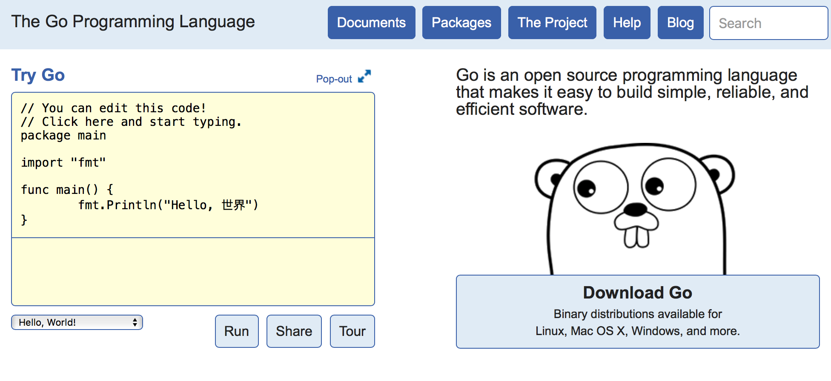
https://golang.org

Slide 7
Installing Go
You should however install it locally
  Follow instructions at https://golang.org/doc/install, simple steps and binaries provided.
  Download and install using the setup and do the following to test your work
  The GOPATH environment variable should be setup

Slide 8
Some editors with support for Go
Visual studio code
SublimeText with GoSublime
Atom with go-plus

Slide 9
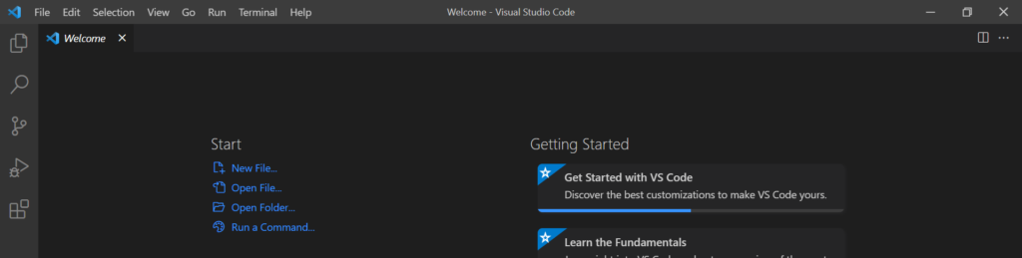

Getting started (Install Visual Studio Code)
Visual Studio Code is the free and open-sourced code editor. It is one of the top most editor used especially for JavaScript application development.
You can download Visual Studio Code according to your OS and system requirements. After download, install it. After opening, it will look like this.
https://www.freecodecamp.org/news/vscode-react-setup/

Slide 10
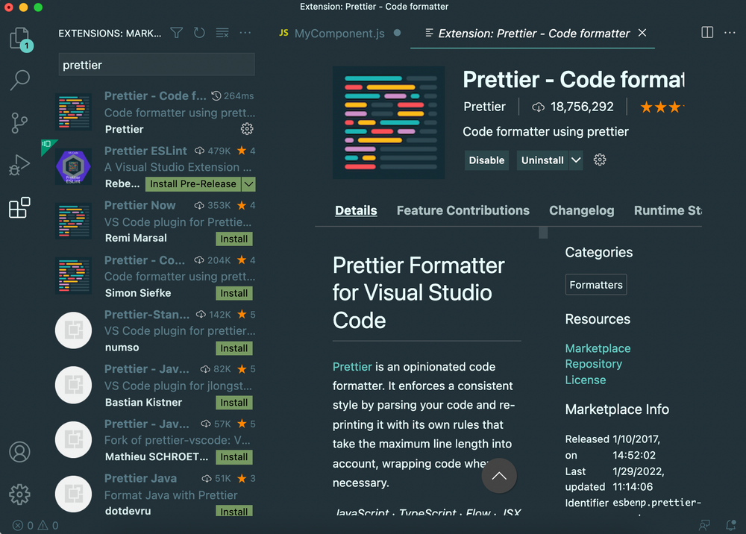
Getting started
(Format your code with the Prettier extension)
To be able to instantly format our code every time we save a .js file, we can again go to the extensions tab (⇧ + ⌘ (Ctrl) + X), type in "prettier" and install it:
https://www.freecodecamp.org/news/vscode-react-setup/

Slide 11
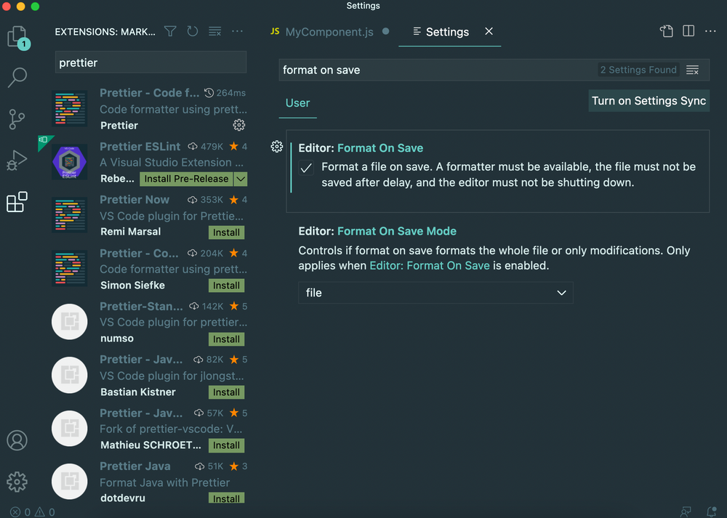
Getting started
(Format your code with the Prettier extension)
Next, we can go back to preferences ->setting, and search for "format on save" and make sure it is checked:
https://www.freecodecamp.org/news/vscode-react-setup/

Slide 12
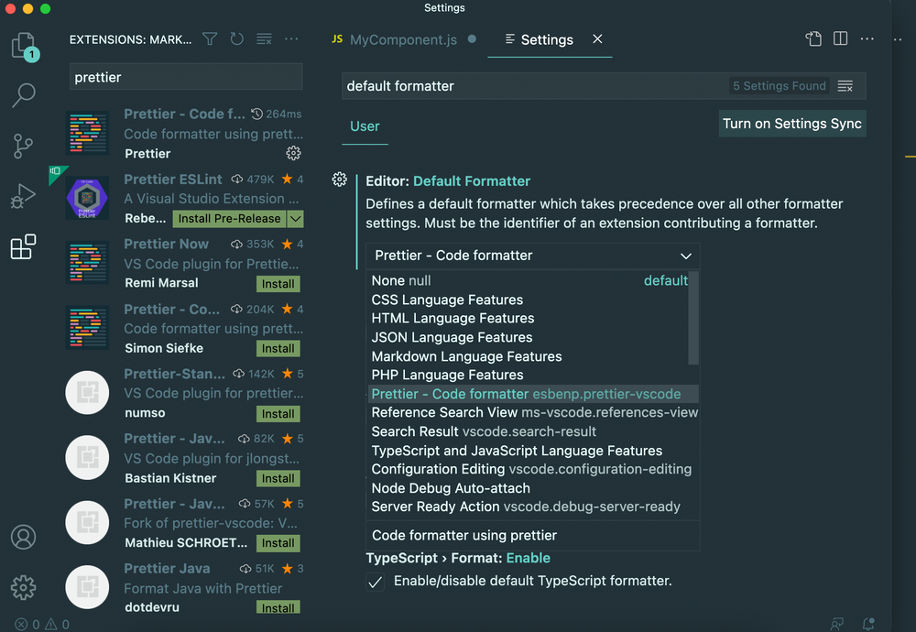
Getting started
(Format your code with the Prettier extension)
Next, we can go back to preferences -> setting, and search for the "default formatter" setting and set it to Prettier
https://www.freecodecamp.org/news/vscode-react-setup/

Slide 13
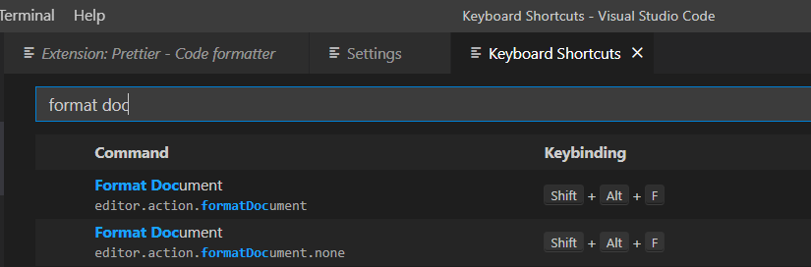
Getting started
(Format your code with the Prettier extension)
Next, we can go back to preferences -> Keyboard shotcuts and look for the shortcut to use for fomatting code.
https://www.freecodecamp.org/news/vscode-react-setup/

Slide 14
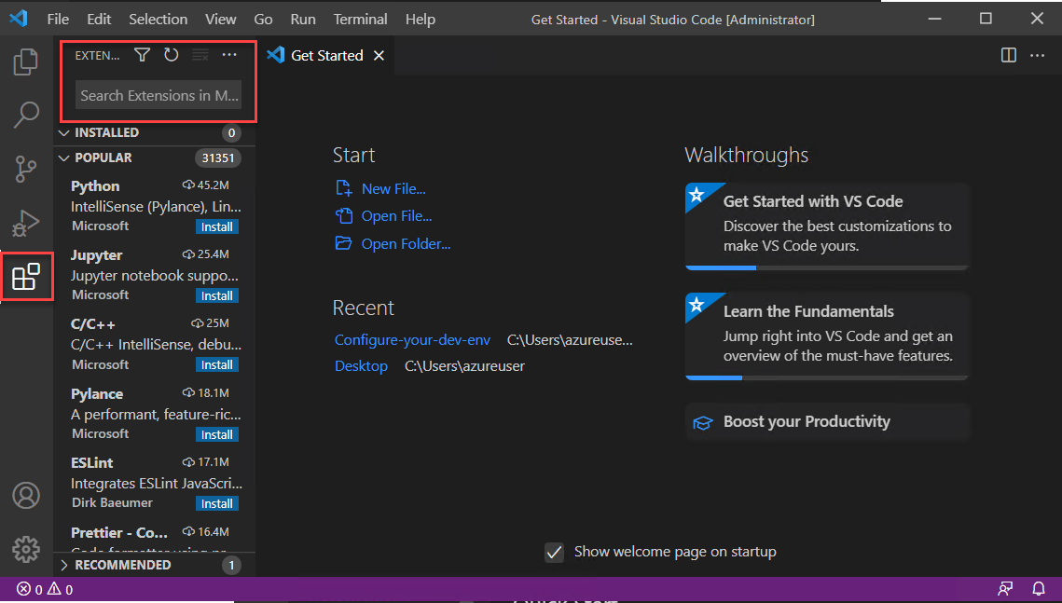
Installing go!
In Visual Studio Code, bring up the Extensions view by clicking on the Extensions icon in the Activity Bar. Or use keyboard shortcut (Ctrl+Shift+X).

Slide 15
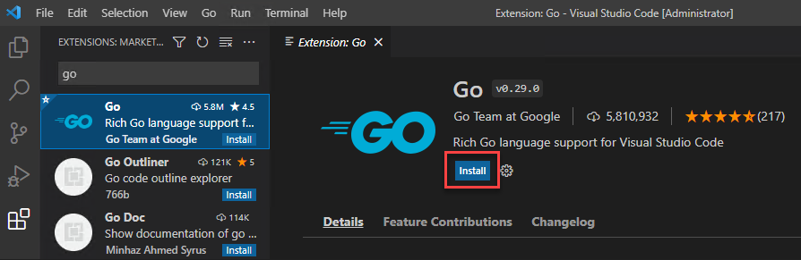
Installing go!
Search for the Go extension, then select install.

Slide 16
Hello World !!
package main
import "fmt"
func main() {
fmt.Printf("Hello, world.\n")
}

Slide 17
Let’s not rush
Before we can move on, it is better to get organized.
Good organization of our code and directories would do wonders ☺

Slide 18
Go and GitHub
The go tool is designed to work with open source code maintained in public repositories.
Although you don't need to publish your code, the model for how the environment is set up works the same whether you do or not.

Slide 19
Workspaces
Go code must be kept inside a workspace.
A workspace is a directory hierarchy with three directories at its root:
  src contains Go source files organized into packages (one package per directory),
  pkg contains package objects, and
  bin contains executable commands.
The go tool builds source packages and installs the resulting binaries to the pkg and bin directories.

Slide 20
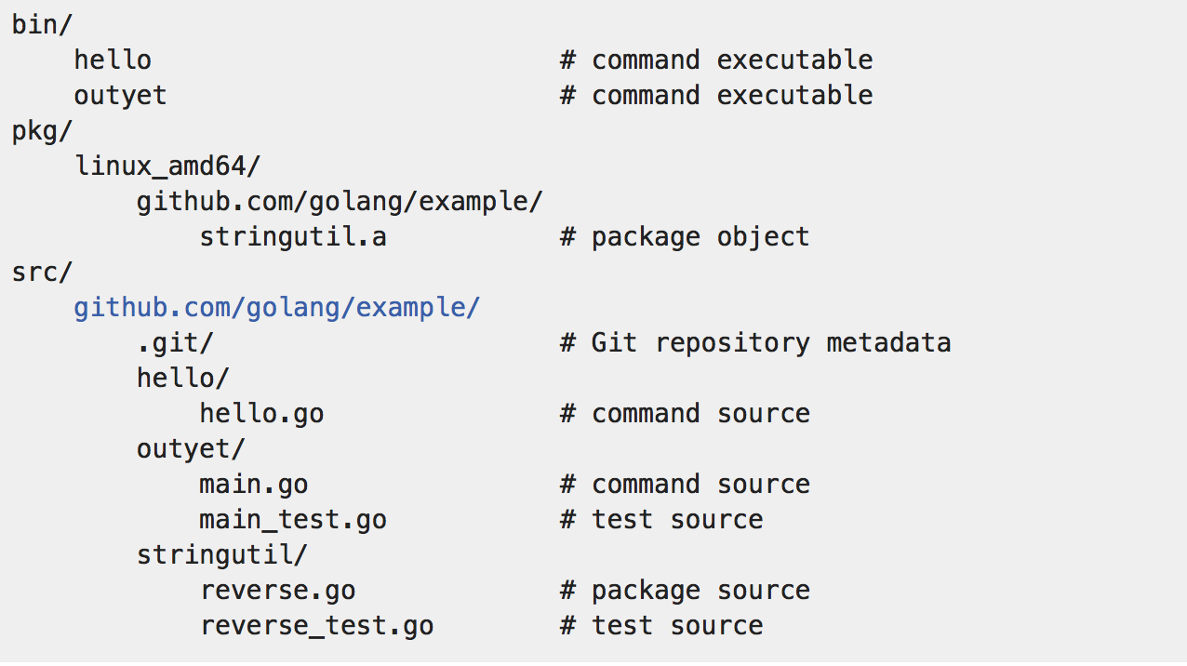
An example

Slide 21
Get ready to use Git!
(Create a Git repository for all your tasks)
Set the name and email for Git to use when you commit:
$ git config --global user.name “Bugs Bunny”
$ git config --global user.email bugs@gmail.com
You can call git config –list to verify these are set.
These will be set globally for all Git projects you work with.
You can also set variables on a project-only basis by not using the
--global flag.

Slide 22
A Tour of Go
http://play.golang.org

Slide 23
Hello World !!
package main
import "fmt"
func main() {
fmt.Printf("Hello, world.\n")
}

Slide 24
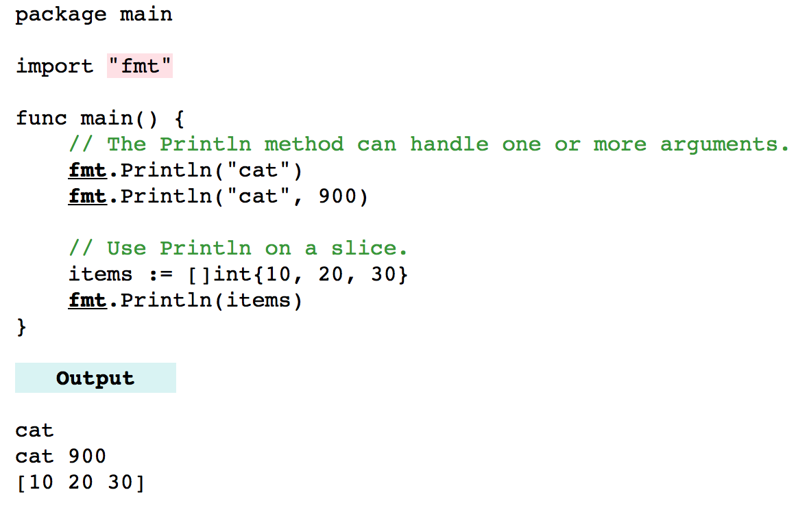
Printing on Console – The fmt package
Notes:
http://www.dotnetperls.com/fmt-go

Slide 25
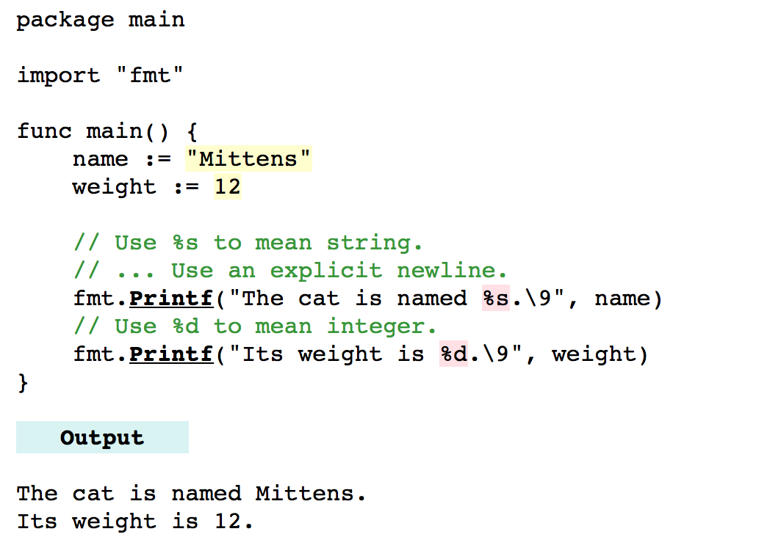
Printing on Console – The fmt package
Notes:
http://www.dotnetperls.com/fmt-go

Slide 26
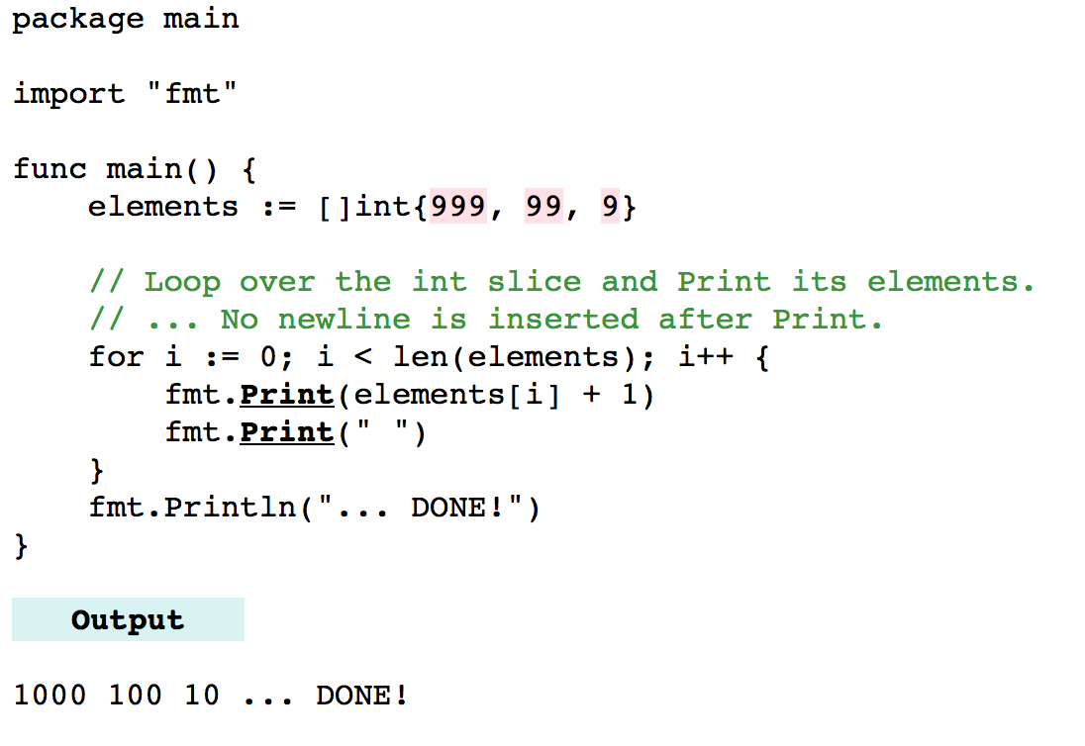
Printing on Console – The fmt package
Notes:
http://www.dotnetperls.com/fmt-go

Slide 27
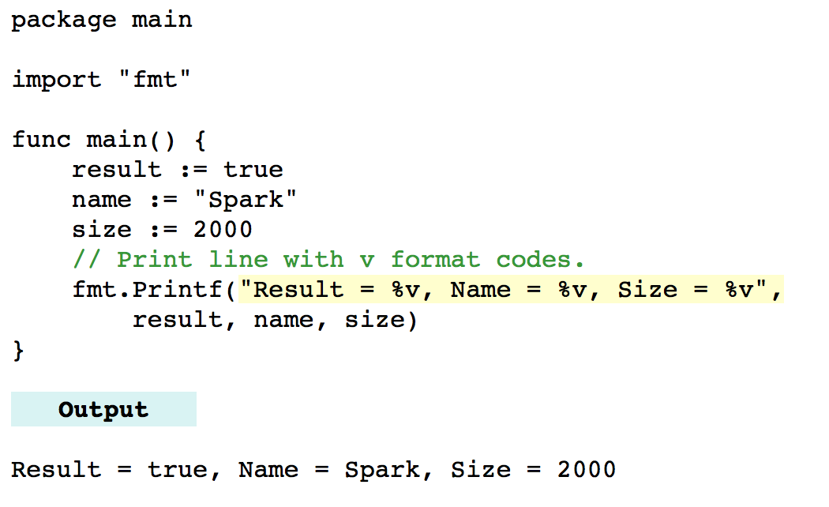
Printing on Console – The fmt package
Notes:
http://www.dotnetperls.com/fmt-go

Slide 28
Arrays

Slide 29

Arrays
Go's arrays are values.
An array variable denotes the entire array; it is not a pointer to the first array element (as in C/C++).
This means that when you assign or pass around an array value you will make a copy of its contents.
var array_name := [length]datatype{values} // here length is defined
or
var array_name := [...]datatype{values} // here length is inferred

Slide 30
Arrays
This example declares two arrays [arr1(inferred) and arr2(defined length)]
package main
import ("fmt")
func main() {
var arr1 = […]int{1,2,3}
//creates a variable of a particular type, attaches a name to it, and sets its initial value
arr2 := [5]int{4,5,6,7,8} // := is called short variable declaration which takes form
var arr3 = [4]string{"Volvo", "BMW", "Ford", "Mazda"}
fmt.Println(arr1)
fmt.Println(arr2)
fmt.Println(arr3)
fmt.Println(arr1[0])
fmt.Println(arr2[2])
fmt.Println(len(arr2))
}

Slide 31
Passing Arrays
Go's documentation makes it clear that arrays are passed by copy.
How to achieve pass by reference?
  Option A - use pointers, complex and less elegant
  Option B - Use slices

Slide 32
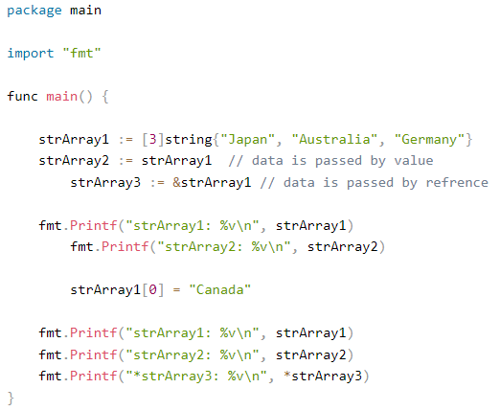
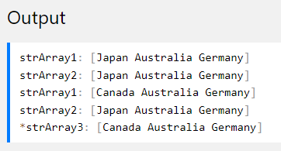
Passing Arrays
Go's documentation makes it clear that arrays are passed by copy.

Slide 33
Go Struct

Slide 34
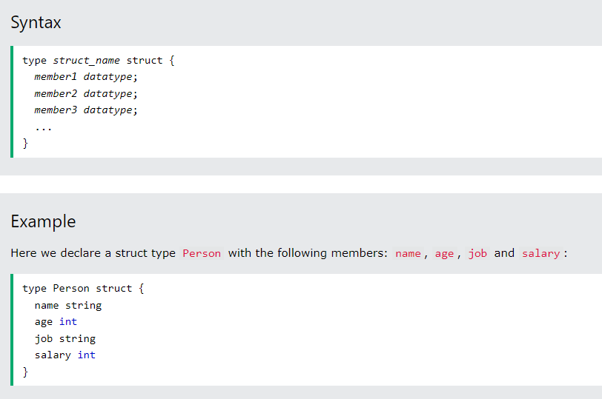
Go Struct
While arrays are used to store multiple values of the same data type into a single variable, structs are used to store multiple values of different data types into a single variable.

Slide 35
Go Struct (Access Struct Members)
To access any member of a structure, use the dot operator (.) between the structure variable name and the structure member:
package main
import ("fmt")
type Person struct {
name string
age int
job string
salary int
}
func main() {
var pers1 Person
var pers2 Person
// Pers1 specification
pers1.name = "Hege"
pers1.age = 45
pers1.job = "Teacher"
pers1.salary = 6000
// Pers2 specification
pers2.name = "Cecilie"
pers2.age = 24
pers2.job = "Marketing"
pers2.salary = 4500
// Access and print Pers1 info
fmt.Println("Name: ", pers1.name)
fmt.Println("Age: ", pers1.age)
fmt.Println("Job: ", pers1.job)
fmt.Println("Salary: ", pers1.salary)
// Access and print Pers2 info
fmt.Println("Name: ", pers2.name)
fmt.Println("Age: ", pers2.age)
fmt.Println("Job: ", pers2.job)
fmt.Println("Salary: ", pers2.salary)
}

Slide 36
Task 1 Pass Struct as Function Arguments
Using the previous example, demonstrate how to pass a structure as a function argument and print its values.
  Function syntax
func FunctionName() {
// code to be executed
}

Slide 37
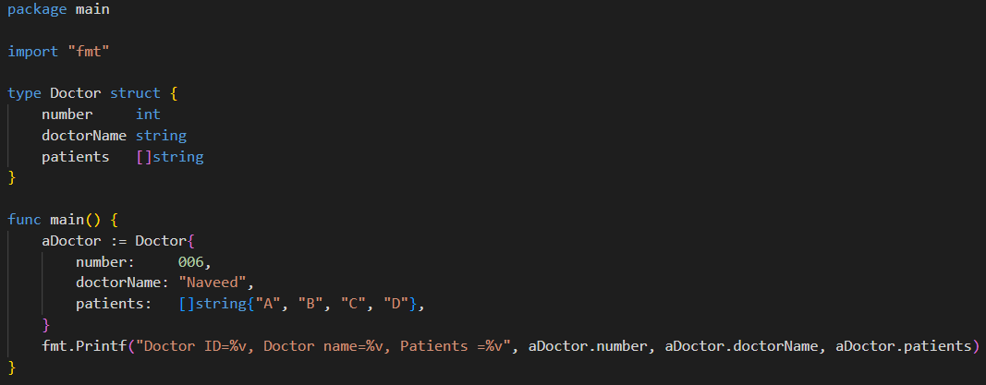
Struct with an Array

Slide 38
Task 2 array of structs
Here, you can see the two different structs. The company struct uses the employee struct as an array. Write a program that do the following:
  Add three employee using the employee struct (e.g., emp1 := employee{"Amir", 80000, "Full-Stack Developer"}
  Create an array of ‘emplys’ by add the above three records (emplys:=[]employee{ …})
  create a company struct and add values to it (e.g., {"Tetra", emplys})
  Print company details
type employee struct {
name string
salary int
position string
}
type company struct {
companyName string
employees []employee
}

Slide 39
Methods with struct
Go methods are similar to Go function with one difference, i.e, the method contains a receiver argument in it.
With the help of the receiver argument, the method can access the properties of the receiver.
func(reciver_name Type)method_name(parameter_list)(return_type)
{
// Code
}

Slide 40
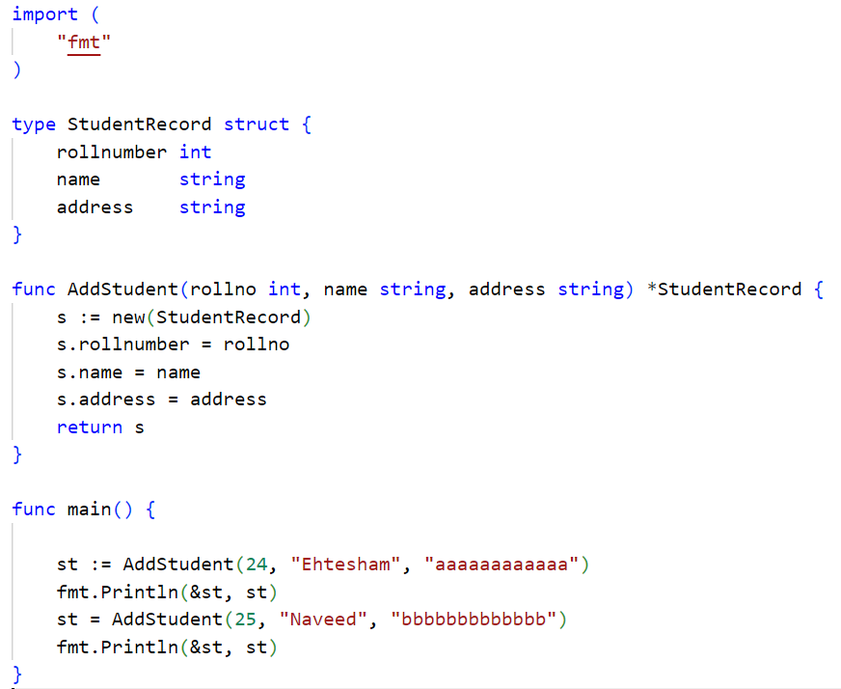
Methods without struct

Slide 41
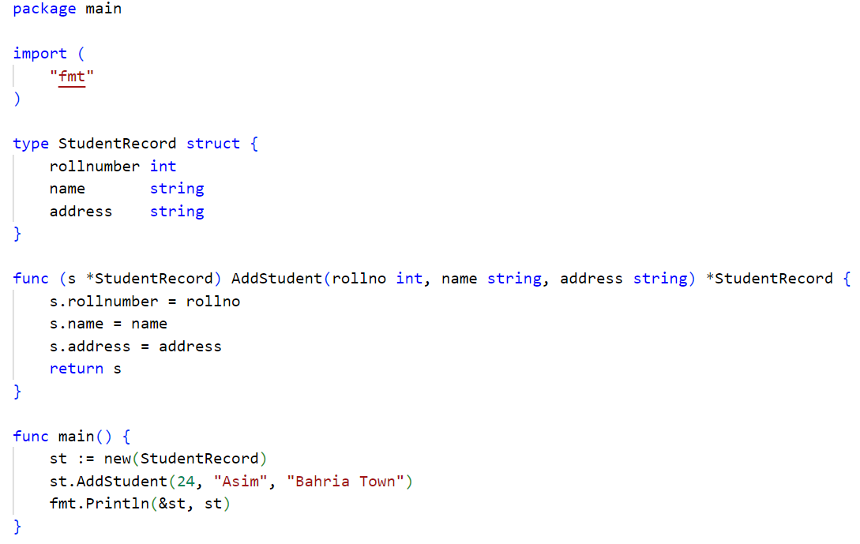
Methods with struct

Slide 42
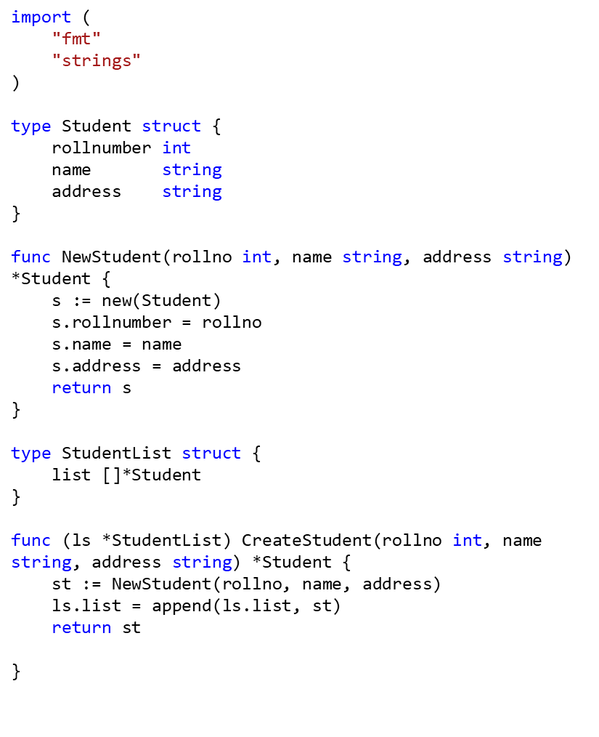
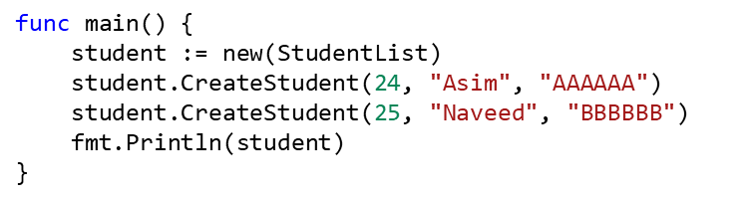
Methods with struct – Creating a list of students

Slide 43
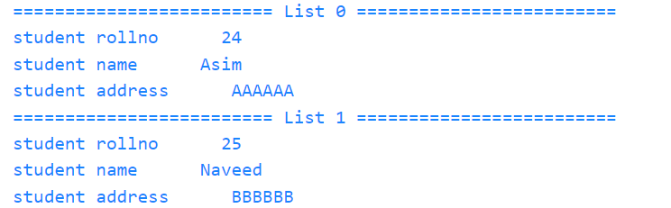
Task 3– Creating a list of students
Currently, the program output the addresses. Your task is to write a Print() method(s) to display the students data from the student list in the format given below
The strings.Repeat can help you print the ‘=‘ for the specified number of time

Slide 44
Calculating Hash
Package sha256 implements the SHA224 and SHA256 hash algorithms as defined in FIPS 180-4
https://pkg.go.dev/crypto/sha256#example-Sum256
package main
import (
"crypto/sha256"
"fmt"
)
func main() {
sum := sha256.Sum256([]byte("hello world\n"))
fmt.Printf("%x\n", sum) //hexadecimal
}

Slide 45
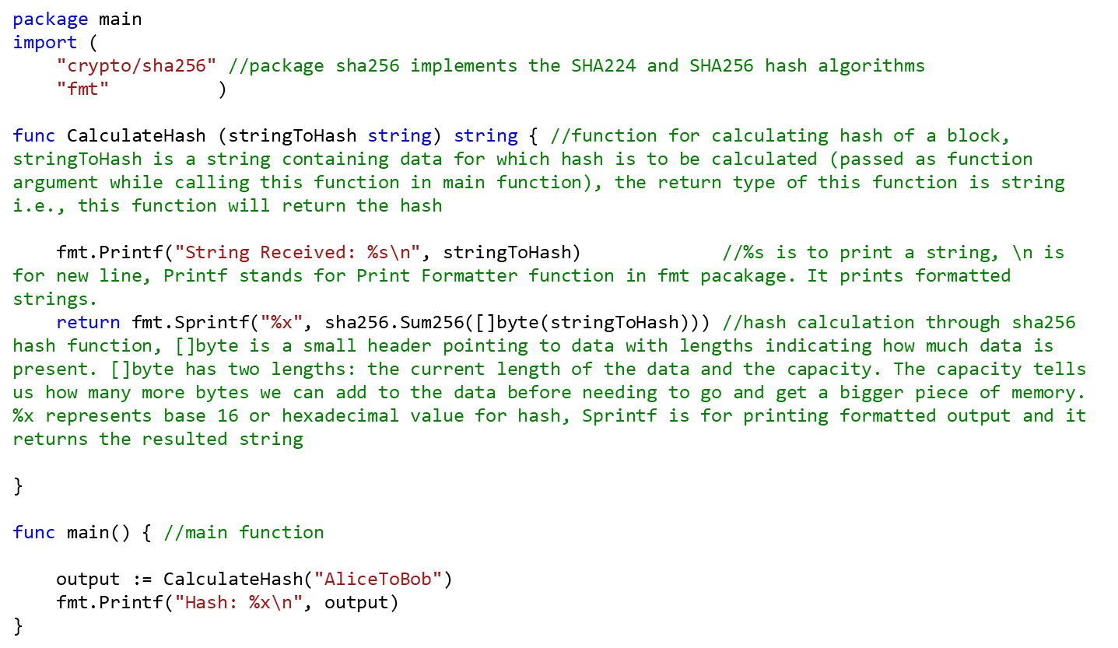
Calculating Hash

Slide 46

Assignment 1

